Slide 1
Introduction to Innovation
Unit – I:
Meaning of Innovation
Difference between innovation and invention
Difference between Innovation and Creativity
Need to be Creative
Importance of Innovation
Innovation as a Competitive Advantage
Innovation Continuum
Innovation Cycle
Disruptive Innovation
Breakthrough innovations and its consequences on the society
Challenges in Innovation.

Slide 2
Meaning of Innovation
Innovation is an act of application of new ideas to which creates some value for the business organization, government, and society as well. Better and smarter way of doing anything is innovation. It could be the introduction of:
New technology.
New product line or segment.
A new method of production.
An improvement in the existing product.
Example
The invention of the motorcycle was the biggest innovation over scooters. In early centuries, people used to travel with scooters, for which they have to make lots of efforts to start it like they need to strike the kick and knee down from either side if it doesn’t start

Slide 3
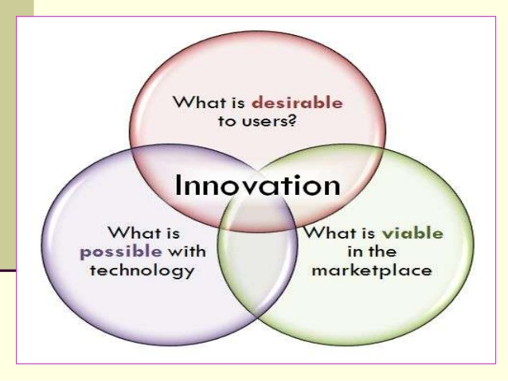
Invention + Commercialization
“Innovation is the search for and the discovery, developed, improvement, adoption and commercialization of new processes, new products and new organization structures and procedures.”

Slide 4
CHARACTERISTICS OF INNOVATION
There is an object or target which is being changed.
It can be a product, a process, an individual’s lifestyle, an organization's strategy, a society culture.
Innovation vary in extent or magnitude i.e. degree to which one deviates from the past.
It is closely related to problem solving since generation & implementation of ideas for change never transpire without difficulty.
A final characteristic is the impact of the change, the significance or range of its effects.

Slide 5
Two important types of Innovations are:
Product Innovation: The introduction of a new product, or a significant qualitative change in an existing product. Example: personal computers, mobile phones, and microwave ovens.
Process Innovation: The introduction of a new process for making or delivering goods and services. Example: A robotic machine to assem­ble cars can deliver welding services with even greater precision than a human welder,
Innovations
Product Innovations
Process Innovations
In Goods
In Services
Technological
Organizational

Slide 6
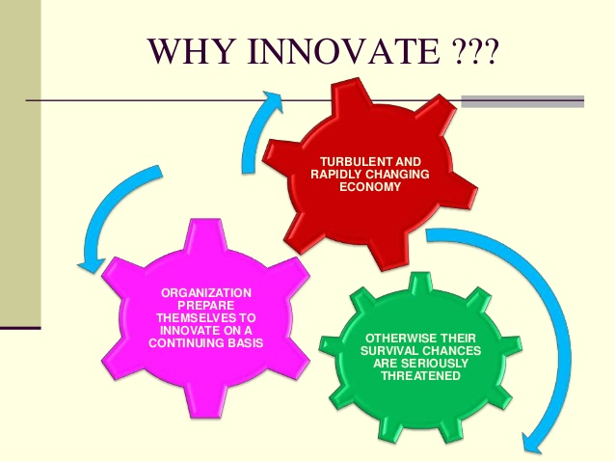

Slide 7

GOALS OF INNOVATION
Improving quality
Creation of new markets
Extension of the product range
Reducing labor cost
Improving production process
Reducing materials
Reducing environmental damage
Replacement of products/services
Reducing energy consumption
Conformance to regulations

Slide 8
Difference between Innovation and Invention
Schumpeter’s distinction between "Invention” and “Innovation”.
An “invention” is an idea, a sketch or model for a new or improved device, product, process or system. It has not yet entered to economic system, and most inventions never do so.
An “innovation” is accomplished only with the first commercial transaction involving the new product, process, system or device. It is part of the economic system.

Slide 9
Difference between Innovation and Creativity
The following are the major differences between Creativity and Innovation:
The quality of thinking new ideas and putting them into reality is creativity. The act of executing the creative ideas into practice is innovation.
Creativity is an imaginative process as opposed to innovation is a productive process.
Creativity can never be measured, but Innovation can be measured.

Slide 10
4. Creativity is related to the generation of ideas which are new and unique. Conversely, Innovation is related to introduce something better into the market.
5. Creativity does not require money. On the other hand, innovation requires money.
6. There is no risk involved in creativity, whereas the risk is always attached to innovation.
7. Creativity is an act of creating new ideas, imaginations and possibilities. Innovation is the introduction of something new and effective into the market.

Slide 11
Need to be Creative
Creativity is the ability to conceive something unpredictable, original and unique. It must be expressive, exciting and imaginative. It is the mirror of how beautifully a person can think in any given circumstance.
Creativity is a brainstorming and mind-blogging activity in which a person has to think beyond his imagination for bringing something worthwhile. It is an activity of unveiling something which was previously hidden.

Slide 12
Creativity is very important in businesses: organizations need it to adapt to the fast-changing environment,
To develop new products and to improve customer services.
Creativity is also a key to the ongoing vitality and survival of organizations.
In response to this need, managers have invested in various targeted approaches, such as, creativity training programmes, team-building, and leadership development to improve it.

Slide 13
Creativity will continue to increase in importance, due to several broad societal and economic trends.
Increasingly, globalized markets result in greater competitiveness, even for industries that historically had been protected from significant challenge.
More and more sophisticated ICT result in shorter product development cycles.
Jobs that don’t require creativity are increasingly being automated, or are moving to extremely low-wage countries.
Growing wealth and leisure time in advanced countries (and beyond) have raised the demand for the products of the creative industries.

Slide 14
5. To give solutions to the complex problems
6. To meet the challenges in efficient manner
7. By creating the new solution to the instant problem using effective resources.
Creativity does not happen inside people’s minds, but in the interaction between a person’s thought and a socio-cultural context.

Slide 15
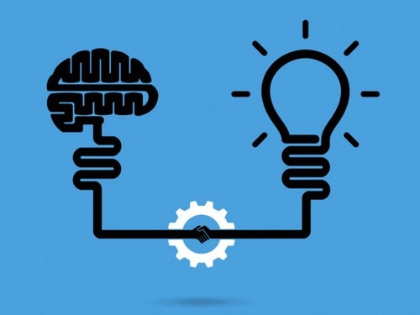
Importance of Innovation
1.Competitive advantage in the market
2. Loyal customers
3. Unique selling proposition
4.Enhanced brand value
5.Constant Improvement
6.Attracts expert talent
7.Growth and Success
8. Creative edge

Slide 16
1. Competitive advantage in the market : The ever-growing competition from the new as well as the established players in the market, evolving tastes of the customers, and the changing norms and policies of the government.
2. Loyal customers: To retain the long list of loyal customers and keep on adding to the list. And that is only possible when the brands are able to solve their pain and problem areas with the product and service offerings that are new, novel, and innovative.
3. Unique selling proposition: Once the brand’s USP is hit amongst the target audience, the unique selling proposition can be arrived and derived on the basis of innovation.

Slide 17
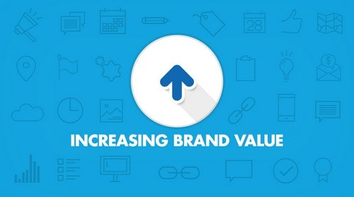

4. Enhanced brand value: high brand value, it is the factor of innovation that makes it possible for them. KFC is known for its unique flavors, APPLE is known for its cutting edge technology, and Louis Vuitton is known for its high-end quality and design elements.
5. Constant Improvement: Innovation, constant improvement, and continuous development; all combined give a competitive edge to the brand.
6. Attracts expert talent: It is quite vital for the firms to understand the Importance of Innovation in order to attract expert and talented workforce.

Slide 18
7. Growth and Success: With the factors and attributes of innovative products and services that are meeting the needs and demands of the customers, expert and talented team of people, through research and development, the company grows and bounds enjoying the pinnacle of success.
8. Creative edge: It can be in design, the functionality of the product or the packaging; the tinge of creativity with innovation is a mandate.

Slide 19

Innovation as a Competitive Advantage
A competitive advantage occurs when an organization develops or obtains a certain attribute that allows them to outperform the competition.
Innovation in larger companies can be a very, very slow process. Take Starbucks for example. If Starbucks is interested in innovating their product line, they must innovate on a very large scale. Planning, preparation, testing, tweaking, and training must all take place before a new product can be rolled out.

Slide 20

In contrast, a small local coffee shop could potentially roll out that same new product in just a few hours (or however long it takes to put the new item on their menu). Innovation doesn't always have to be related to the product either.
Innovation in service, delivery, and atmosphere can occur much easier and quicker for a small innovation. The reason? Large companies are just too big to be able to "pivot" (or quickly change) like a small business can.

Slide 21
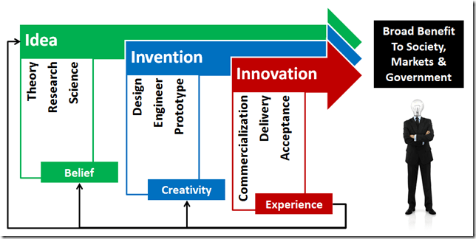
Innovation Continuum
Idea – theory, research, science
Invention – design, engineer, prototype
Innovation – commercialization, delivery, acceptance

Slide 22
Innovation as a context can apply across all steps in the continuum, And, for the thing going through the process continuum, it doesn’t become an innovation until it is commercialized, delivered and accepted to be fit for the purpose it was designed.
Once an innovation is accepted by users, experience builds and the opportunity to suggest new ideas for improvement start the cycle all over again.
Many times, the cycle is started by adding creative new elements to the current invention – sometimes called continuous innovation.
Other times, our beliefs are challenged and heretofore impossibilities become possible and that drives a radical innovation.

Slide 23
Innovation Cycle
Idea Generation and Mobilization
Innovation Cycle
Diffusion and Implementation
Advocacy and Screening
Commercialization
Experimentation

Slide 24
1. Idea Generation and Mobilization
New ideas are created during idea generation. Mobilization occurs when the idea is moved to a different physical or logical location, such as an outside firm or another department.
Inspiration for a new idea can originate from an improvement of an existing idea, or something from scratch. The Atlantic opens in new window explains how Apple waited three years after MP3 players were introduced to create the iPod, which was attractive, intuitive and offered capacity for up to 1,000 songs.
2. Advocacy and Screening
Advocacy and screening help evaluate an idea and measure its potential benefits and problems. From there, a decision can be made about an idea’s future.

Slide 25
First, employees should have plenty of avenues to receive advocacy and feedback.
Second, organizations must understand the difficulties involved with evaluating truly innovative ideas.
Third, organizations need to build transparent evaluation and screening protocols.
3. Experimentation
The experimentation stage tests an idea, such as with a prototype or pilot test. Sometimes, experimentation leads to new ideas due to information that is gathered on the results and the overall feasibility of the original idea. Time is crucial in this process; individuals must be given adequate time to run the experiments

Slide 26
4.Commercialization
Commercialization aims to create market value for an idea by focusing on its potential impact.
This step makes the idea appealing to the audience, such as by packaging an idea with other ideas, clarifying how and when the idea can be used, and using data or prototypes from experiments to demonstrate benefits.
After the idea is clarified and a business plan is created, it will be ready for diffusion and implementation.
5. Diffusion and Implementation
Diffusion is the companywide acceptance of an innovative idea, and implementation sets up everything needed to develop and utilize or produce the innovation.
Also important to diffusion and implementation is the opportunity for future ideas; this final stage allows the organization to determine the next set of needs for customers. Receiving feedback, in addition to indicators for success metrics and other benchmarks, enables the organization to stimulate the innovation process once again

Slide 27
Disruptive Innovation
Disruptive Innovation Clayton Christensen introduced the concept of disruptive innovation in his classic book The Innovator’s Dilemma. These tend to be new approaches to old products and services.
An example of a modern disruptive innovation is the internet, which significantly altered the way companies did business and which negatively impacted companies that were unwilling to adopt it.
Here are the five most disruptive technologies: artificial intelligence, block chain, 3D printing, and IoT.

Slide 28
Breakthrough Innovations and its consequences on the society
Thomas Kuhn called this “revolutionary science” because it involves a paradigm shift. In this case, the problem is well defined, but the path to the solution is unclear, usually because those involved in the domain have hit a wall.
Often, a particular field has trouble moving forward because they need a new approach.
Transistors and the discovery of the structure of DNA are both good examples of breakthrough innovation.

Slide 29
Few Examples of Break through Innovations
The iPhone : One of the best cited examples of breakthrough innovation on the tech front is the first iPhone. – Apple
Microsoft has also rethought its business model to develop a breakthrough innovation in the form of Office 365. This saw the company go from selling its Office suite as a product, paid for on a one-off basis, to offering it as a monthly or annual subscription.
Rethinking the business model surrounding shaving has proved to be lucrative: The Dollar Shave Club now has 3.2 million members and has recently been Acquired by Unilever for a reported $ 1 billion.

Slide 30

Break-Through and Disruptive Innovations
Breakthrough Innovation takes a current process or product and typically provides greater efficiency or cost effectiveness. It can be considered Disruptive if that increased efficiency or cost effectiveness threatens to make the competition's business model obsolete. Example: The internal combustion engine has been around for over 100yrs and there have been major breakthroughs during that time. The overall efficiency of these engines has improved greatly over this period. However these improvements have been realized by just about all the auto companies and have not really threatened the core business model. Disruptive - When Toyota came out with the Prius, the Hybrid became more of a disruptive technology as it was able to realize greater efficiencies than the competition's ultra efficient engines. This helped Toyota to overtake GM at the time as the largest automaker in the world.
However the biggest disrupter about to hit the auto industry over the next decade is the Electric Car. The models sold by Tesla Motors achieve over 100MPGs without sacrificing performance, design, or comfort. This EV technology truly threatens the old automotive model..

Slide 31

Challenges in Innovation
Lack of Innovation Culture: It reveals that Indians are probably risk-averse, hesitant to make important decisions in work-related matters, and probably lack attitude to take initiative.
Lack of Innovation Ecology: it has been found, out of the graduates passing out of professional institutes only 25% of engineers, 15% of finance and accountancy professionals, and 10 % of graduates with Indian degrees are employable by multinational companies.

Slide 32
Lack of Venture Capital: There is general lack of venture capital for start-ups who want to experiment with new ideas.
Corruption in the System: “there are five basic reasons for corruption in India.
(1) scarcity of goods and services;
(2) red tape and complicated rules and procedures;
(3) lack of transparency in decision-making;
(4) legal cushions of safety for the corrupt under the “healthy” principle that everyone is innocent till proved guilty; and
(5) tribalism among the corrupt who protect each other.”

Slide 33

Employees aren't empowered to innovate.
Employees aren't motivated to innovate.
You're missing an innovation strategy.
Innovation is centralized to one functional group.
Lack of collaboration.
Lack of diversity.
Current product offerings are successful.
Missed connections with customers.

Slide 34
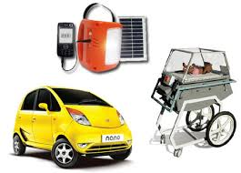
Frugal Innovation

Slide 35
Frugal Innovation
Design to extreme affordability
Strategic thinking towards volume markets
Creativity and innovation towards extreme affordability
Design, engineer and produce for marginal markets
Translating and innovating a high margin brand for low margin markets
Creating and innovating towards branded and quality products for marginal markets

Slide 36

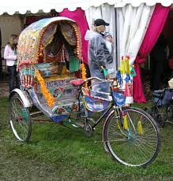
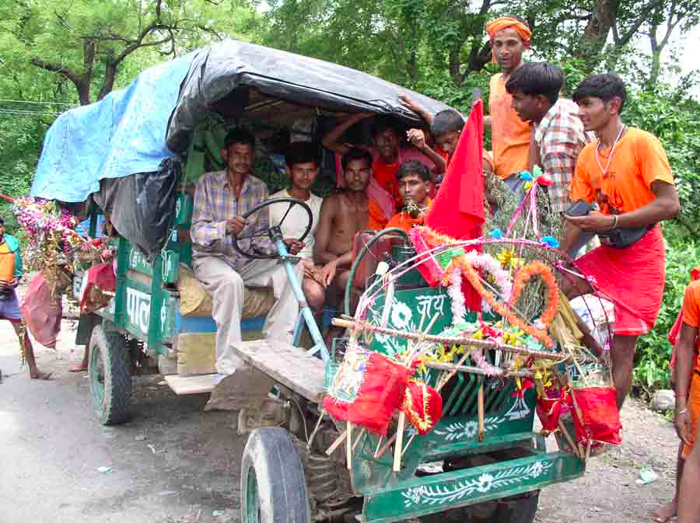
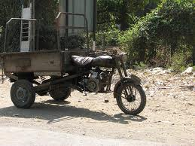

Slide 37

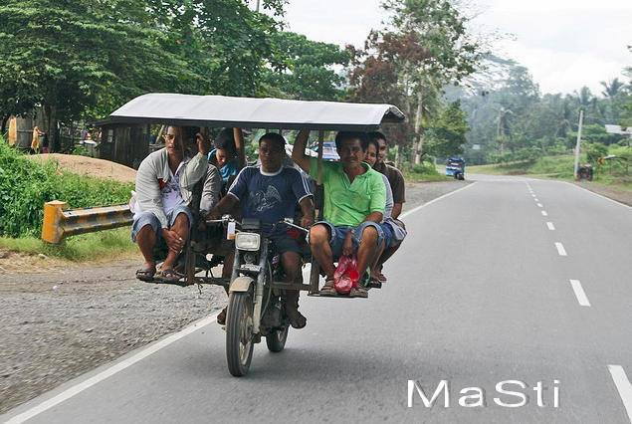

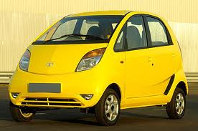

Slide 38
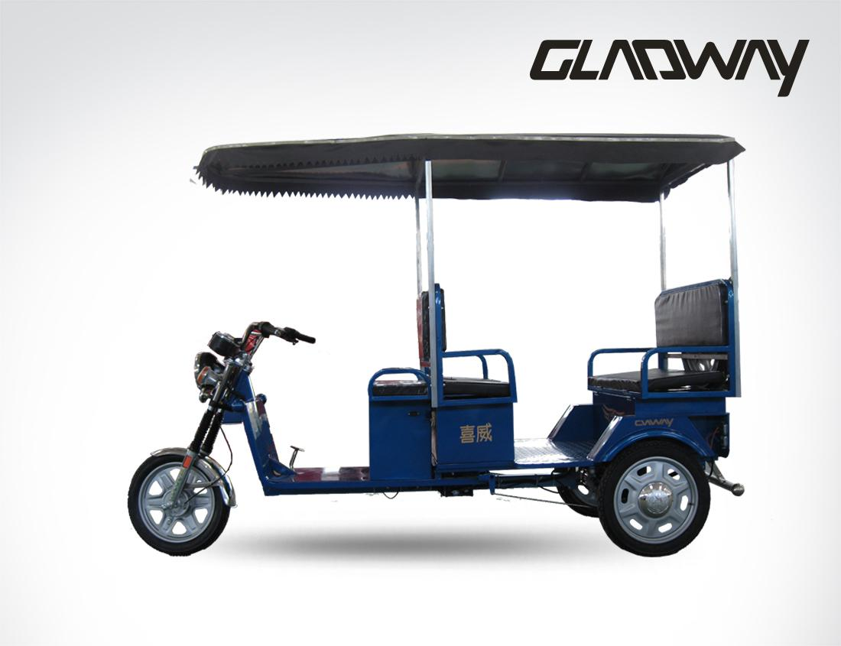
Electric Tricycle

Slide 39
Example :Service Sector-Microfinance
Microfinance is the offer of financial & non-financial services to people excluded from the traditional banking system. The services are adapted to the needs of the target populations.
MICRO
FINANCE
Micro-entrepreneurs
Self-employed
Low income populations
Excluded populations
Business & educational loans
Savings
Micro-insurances
Remittances
Micro-entrepreneur training
Coaching & workshops on health, hygiene, etc.

Slide 40

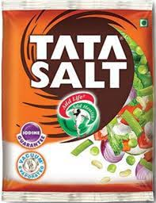
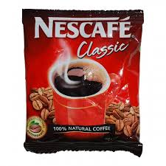
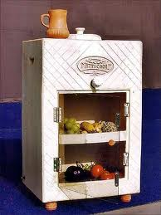
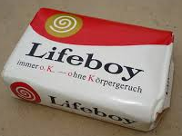
Fast Moving Consumer Goods
Sampoo
Bathing Soaps
Beauty Items
Utensils
Coolers and ACs
Refrigerators
TV sets
Washing Machine

Slide 41

Hot Water Maker

Slide 42

Prefabricated Houses

